Slide 1
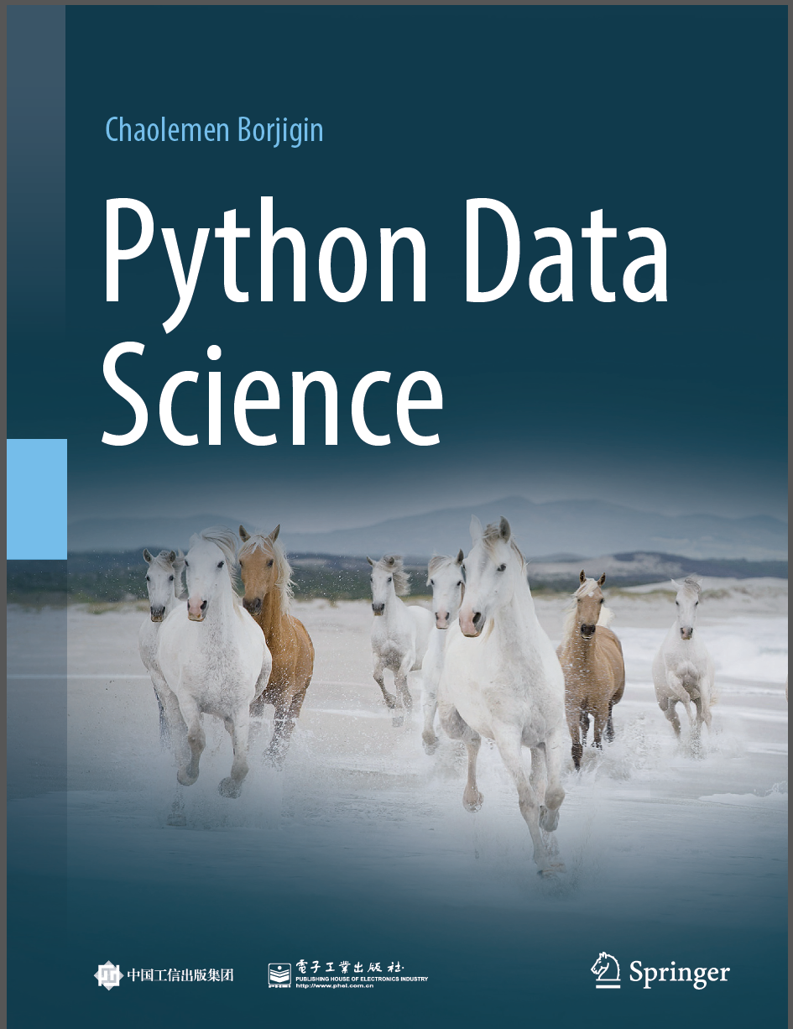
Python Data Science
Chaolemen Borjigin
Renmin University of China
chaolemen@ruc.edu.cn

Slide 2
2.6 Comments
▼ Chapter 2 Basic Python Programming for Data Science
► 2.6 Comments
Chaolemen Borjigin
Renmin University of China
chaolemen@ruc.edu.cn

Slide 3
Summary of this chapter
▼ Chapter 2 Basic Python Programming for Data Science
► 2.6 Comments
2.6.1 Line comments
2.6.2 Block comments

Slide 4
2.6.1 Line comments
▼ Chapter 2 Basic Python Programming for Data Science
► 2.6 Comments
In[1]:
x=1
# y=2
print(x)
Out[1]:
1

Slide 5
2.6.1 Line comments
▼ Chapter 2 Basic Python Programming for Data Science
► 2.6 Comments
In[2]:
x=1
# y=2
print(y)
---------------------------------------------------------------------------
NameError Traceback (most recent call last)
<ipython-input-2-f9b039d12571> in <module>
1 x=1
2 # y=2
----> 3 print(y)
NameError: name 'y' is not defined

Slide 6
2.6.2 Block comments
▼ Chapter 2 Basic Python Programming for Data Science
► 2.6 Comments
In[3]:
x=1
y=2
'''
This is
a
multiline comment
in python
'''
print(y)
Out[3]:
2

Slide 7


